Slide 1

Anomaly detection in vessel traffic

Slide 2
Quick Recap
Research paper
Neural network predictions

Slide 3
This week
2 approaches
Neural Network
Statistical Approach

Slide 4
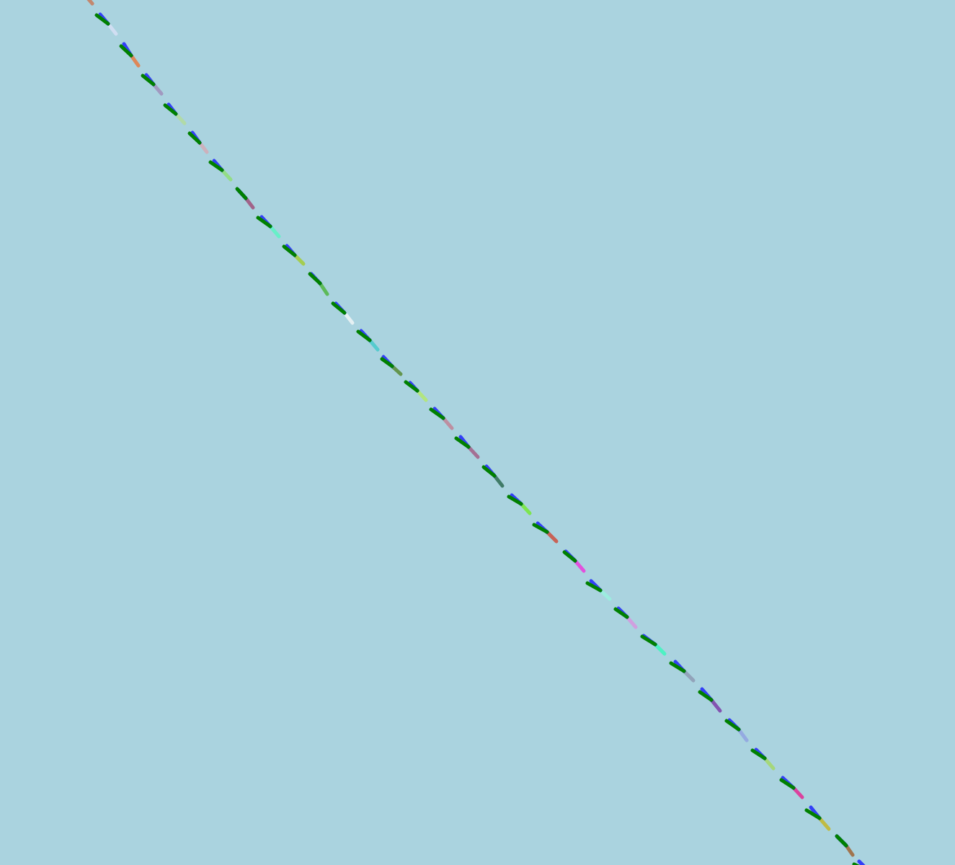
NN predictions
file:///home/stephan/Pictures/8.png
lat/lng + difference with previous point
Sometimes quite accurate

Slide 5
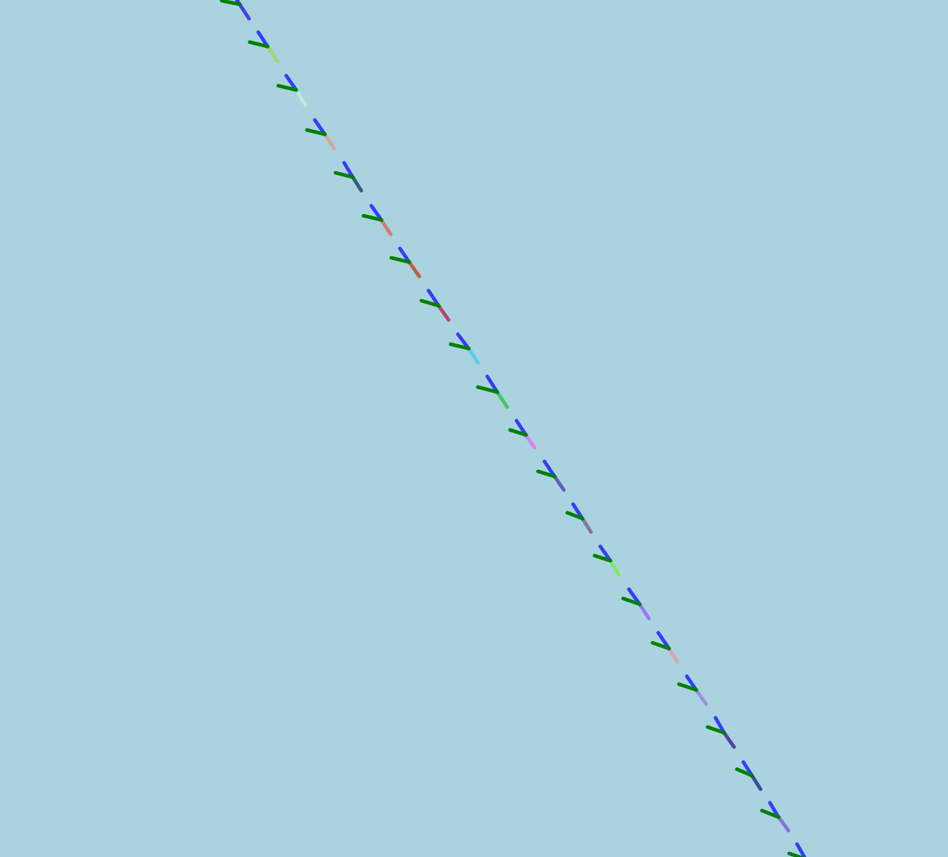
NN predictions
lat/lng + difference with previous point
Other times not so much

Slide 6
NN predictions - next step
Improve the model further
features (course, speed)
nodes / layers (experiment what helps)
Test on more ships

Slide 7
Statistical approach
Angular speed
4 sigma
Density map

Slide 8
Questions?

